Slide 1
Emergency operation (Malfunction of electronic controller)
Model LXE10E type can operate without electronic controller in an emergency case.
In the following cases, unit starts/ stops by use of the Circuit breaker
Emergency
mode
Emergency operation
Cool
Compressor : Continuous operation
(* Compressor does not stop when inside reaches set point.)
Evaporator fan : Run at low speed
Condenser fan : Run
Expansion valve : Fixed opening
Suction modulating valve : 100% Open
* Reverse phase protection board protects scroll compressor’s reverse
operation.
⇒ Please refer to “ PROCEDURE 1”.
Heating
Compressor : Off
Evaporator fan : Run at high speed
Condenser fan : Off
⇒ Please refer to “ PROCEDURE 2”.

Slide 2
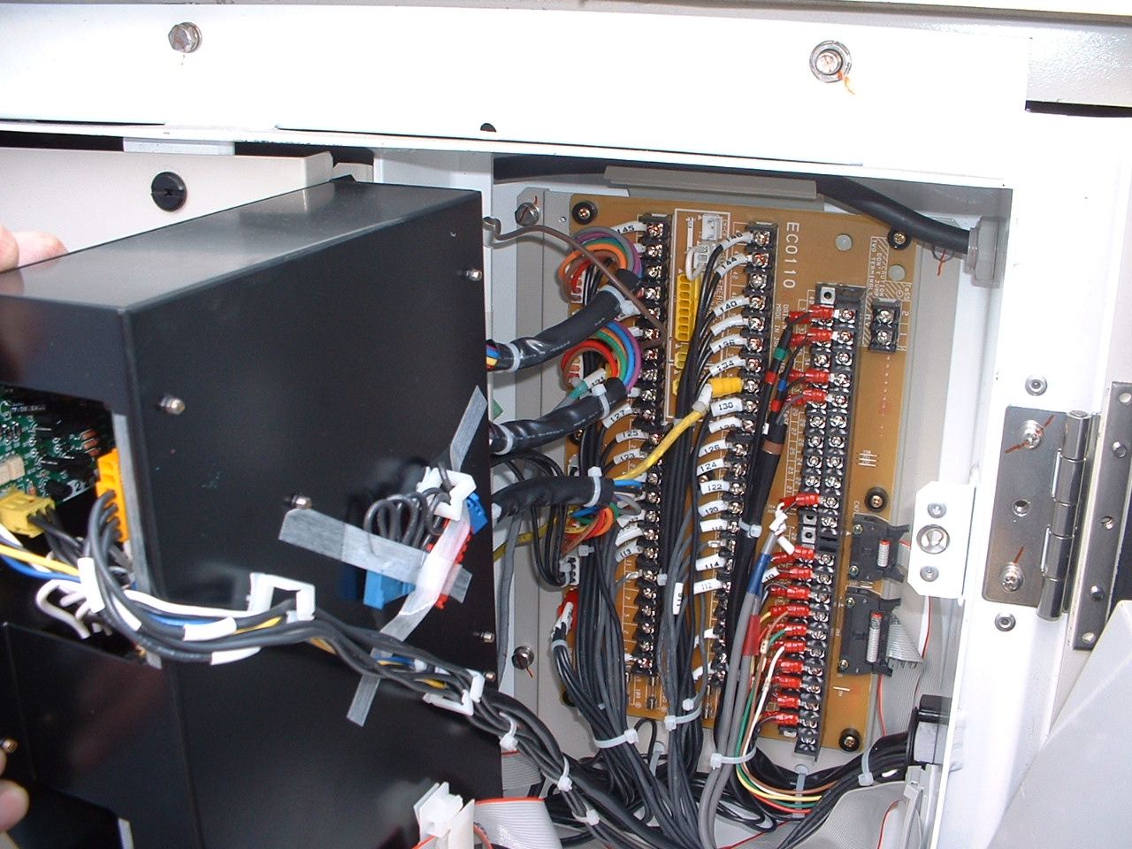
Procedure 1 : For cooling operation
Step 1 : Setting of electronic controller
Step 2 : Setting of Electronic expansion valve
Step 3 : Setting of Suction modulating valve
Step 1-1
Find connector on the back of electronic controller
Emergency connector receptacle
CN5 : Power supply connector
Emergency connector 1 and 2
(For COOL / HEAT)

Slide 3
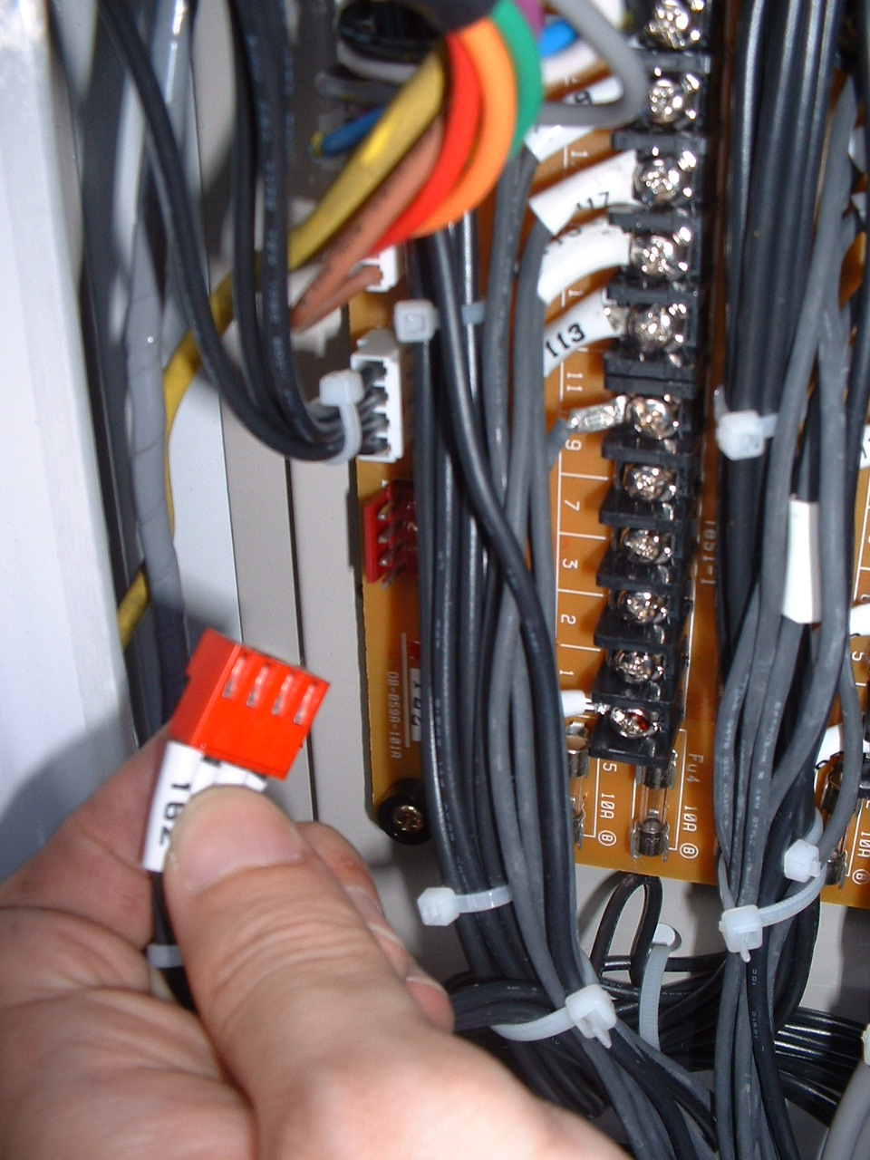
Step 1-2
Disconnect power supply connector ( CN5 )

Slide 4
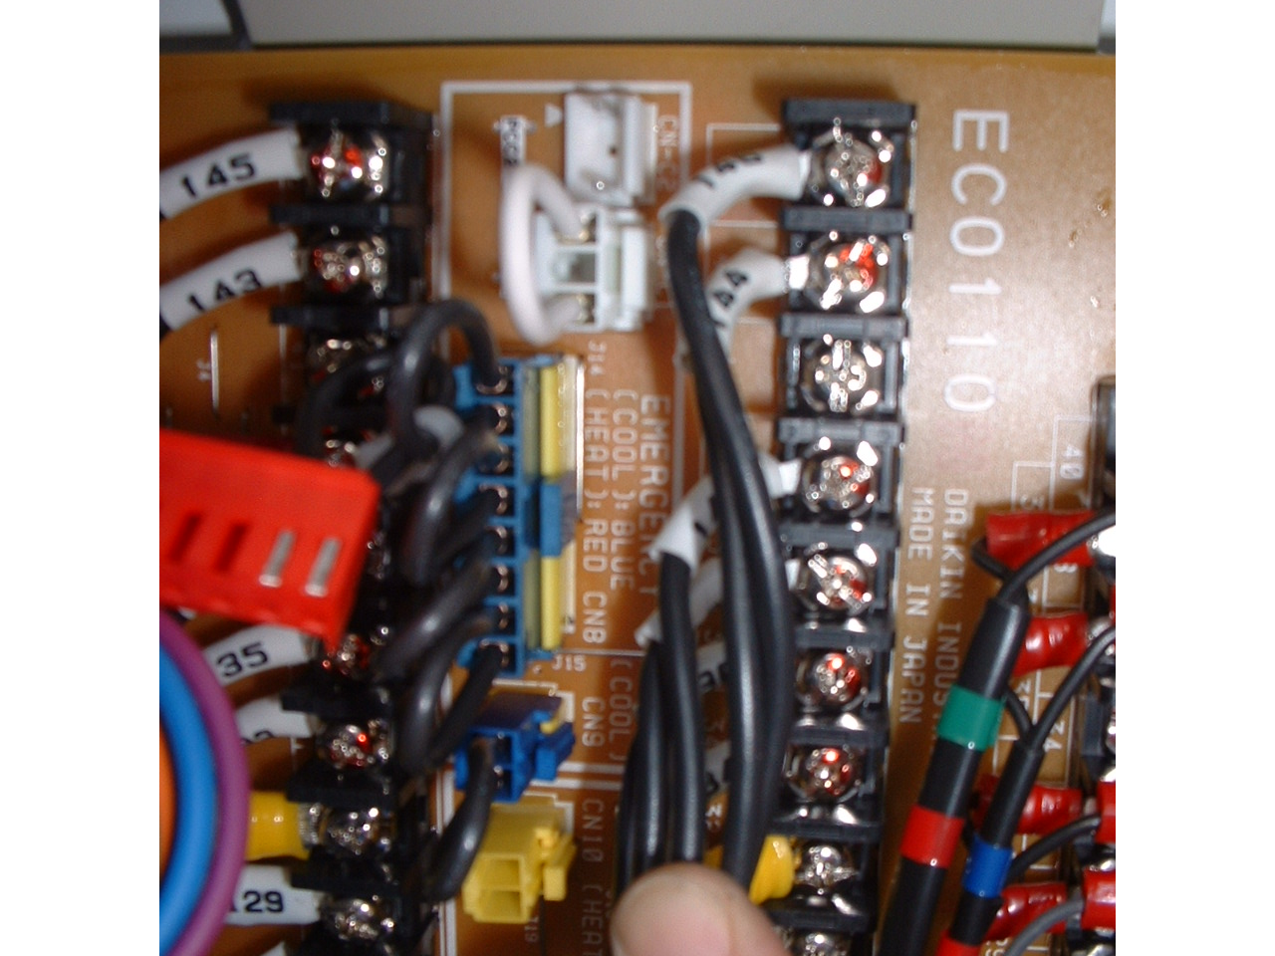
Step 1-3
Remove “YELLOW cap” on the emergency
connector receptacle and Connect “ Emergency
connector 1 and 2” to Emergency connector receptacle.
Emergency connector 1 (8 pin) CN8
Emergency connector 2 ( 2 pin) CN9
Continue to step 2

Slide 5
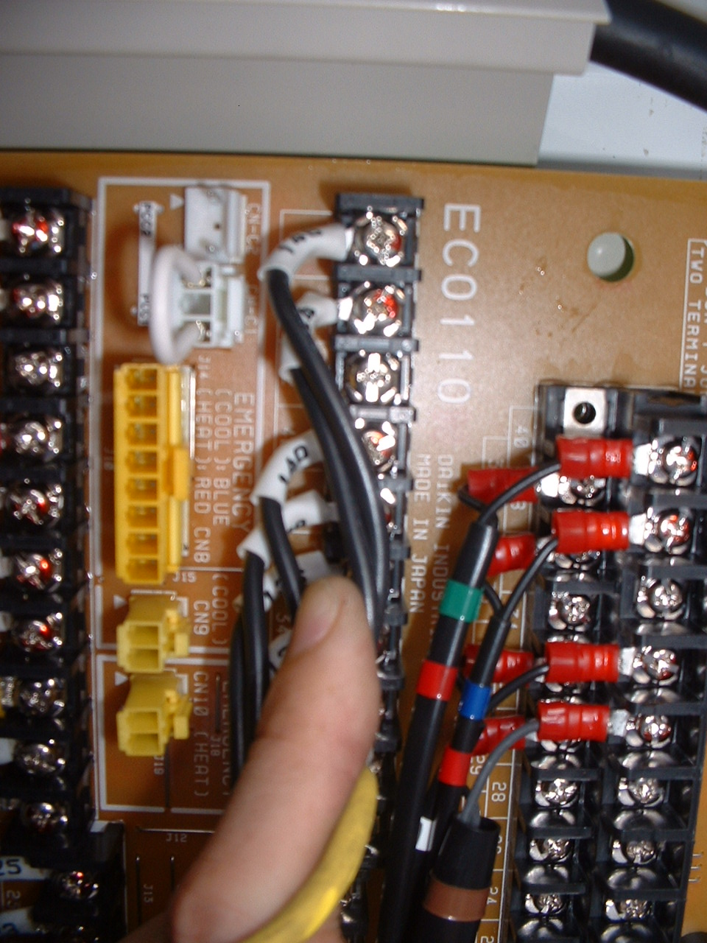
< Reference : Emergency connector receptacle >
CN-C1, CN-C2 :
Phase selection ( PCC1 / PCC2 )
* When condenser fan runs reverse,
please re-connect this WHITE connector to other side
( PCC1 ⇒PCC2 ｏｒ PCC2 ⇒ PCC1)
CN8 : Emergency connector 1 ( 8 pin )
1) When user want COOL operation,
Put “BLUE” connector to this receptacle
2) When user want HEAT operation,
Put “RED” connector to this receptacle
CN9 : Emergency connector for COOL ( 2 pin )
*When user want COOL operation,
Put “2 pin” connector to this receptacle
CN10 : Emergency connector for HEAT ( 2 pin )
*When user want HEAT operation,
Put “2 pin” connector to this receptacle

